Slide 1
Presentation on ExamResultSearchApp
Presented By:
Arpit Dubey
Sonam Bharti
Akhil Pakala
Nagaramya Kilaru
Chakradhara Gembali
Guided By:
Rama Shankar sir

Slide 2
Table of content:
About the Project
About the microservices 1
About the microservices 2
Tools and technologies used
Architecture and designs
Unit Test Coverage
Use case of the Application

Slide 3
Project Name: ExamResultSearchApp
Details: This is a microservices spring boot application. which is used to process the student exam result for different use cases.
The use cases are shown below:
Search Result
Store Result
Update Result
Delete Result
Architecture: There are two microservices used here:
Student-Result
Result-Processor

Slide 4
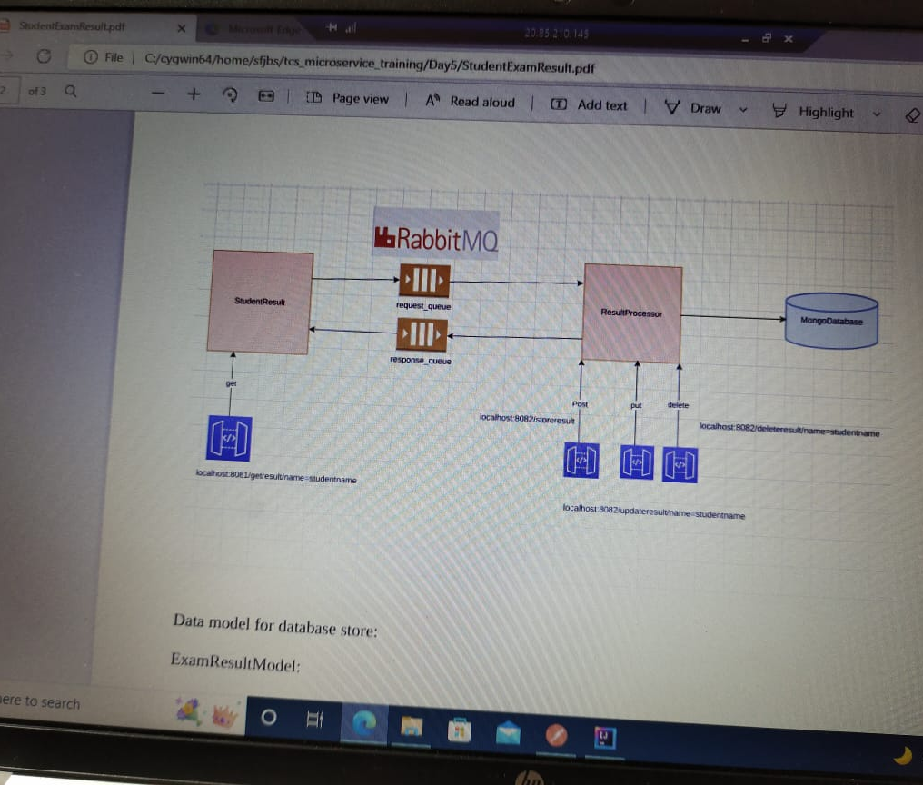
Architecture
A microservices architecture consists of a collection of small, autonomous services. Each service is self-contained and should implement a single business capability within a bounded context. A bounded context is a natural division within a business and provides an explicit boundary within which a domain model exists.

Slide 5
Microservices 1
The microservice StudentResult expose one Rest Endpoint used to search the result of student based on studentname query parameter.
Ex: /getresult/name=studentname (GET).
The end point has access only by user authorization.
The microservice 1 has different content which includes pom file, controller,component package, model package,main class.

Slide 6
Microservices 2
The microservice ResultProcessor expose three Rest endpoints used to store, update and delete exam result as following:
Ex: /storeresult (POST)
Ex: /updateresult/name=studentname (PUT)
Ex: /deleteresult/name=studentname (DELETE)
The above all three end points should be only access for admin user.
The microservice 2 has different content which includes pom file, controller,config package, model package,main class,service package.

Slide 7
Tools And Technologies Used
Virtual Machine
Postman
IntelliJ
Cygwin
Docker
MongoDB
RabbitMQ
Maven

Slide 8
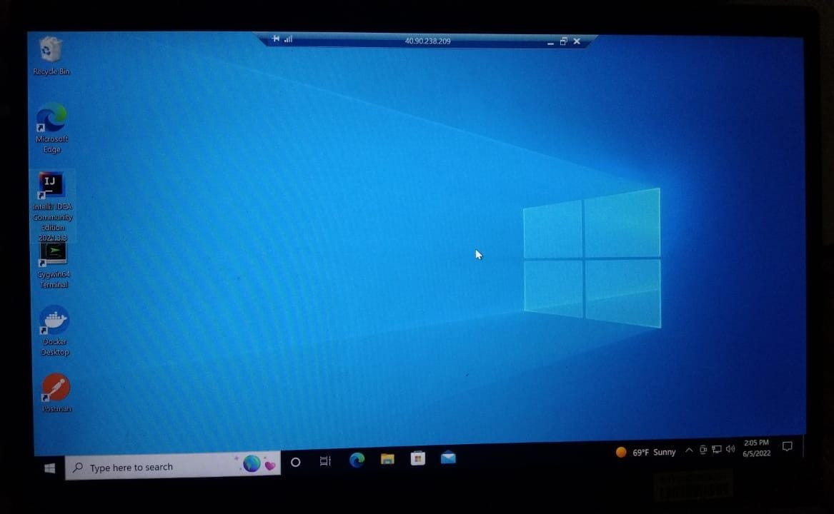
Virtual Machine
A virtual machine (VM) is a digital version of a physical computer. Virtual machine software can run programs and operating systems, store data, connect to networks, and do other computing functions, and requires maintenance such as updates and system monitoring.

Slide 9
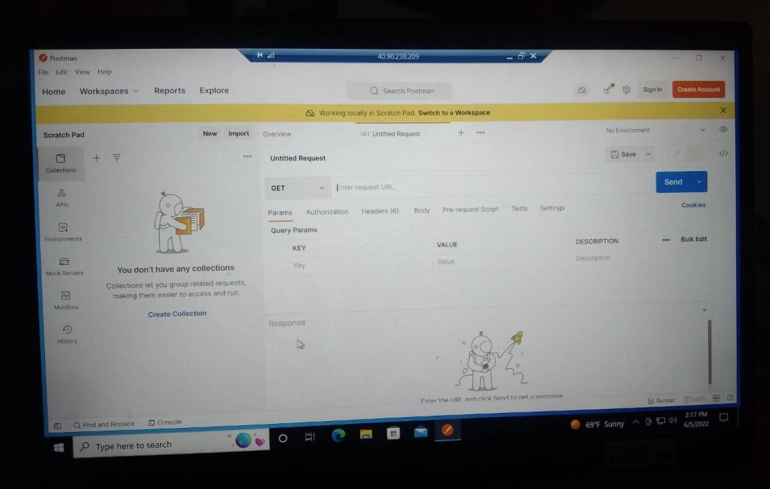
Postman
Postman Console is analogous to a browser’s version of the developer console, except that it’s tuned for API development.If an API or API test is not behaving as you expect, this would be the place where you will go to deep dive while debugging the same.

Slide 10
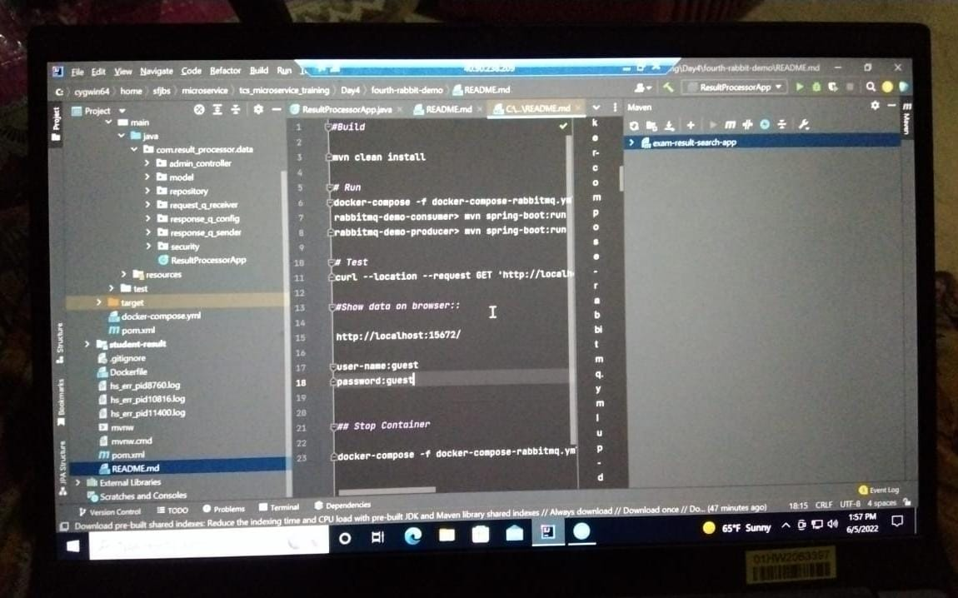
IntelliJ
IntelliJ is one of the most powerful and popular Integrated Development Environments (IDE) for Java. It is developed and maintained by JetBrains and available as community and ultimate edition. This feature rich IDE enables rapid development and helps in improving code quality.

Slide 11
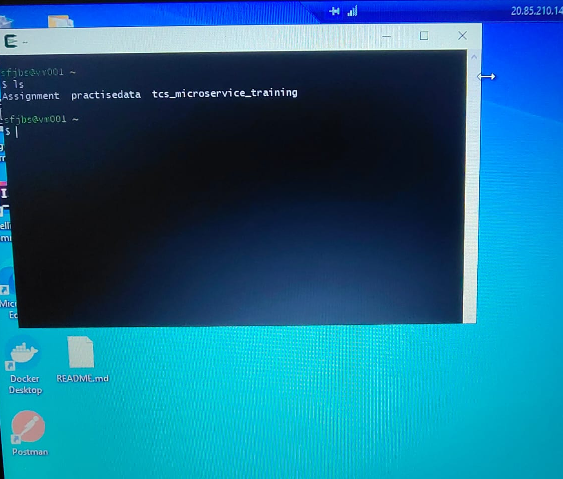
Cygwin
Cygwin is a collection of open source tools that allows Unix or Linux applications to be compiled and run on a Microsoft Windows operating system (OS) from within a Linux-like interface.

Slide 12
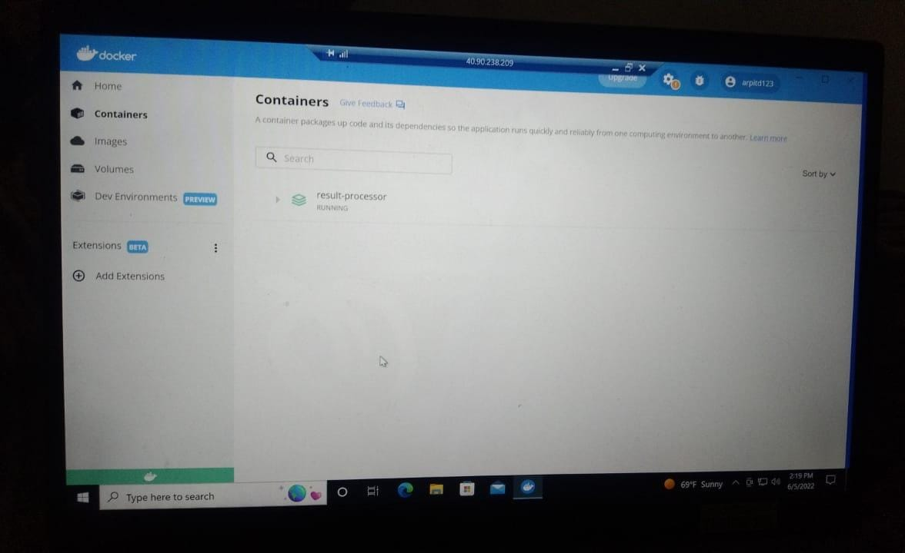
Docker
Docker is a software platform that allows you to build, test, and deploy applications quickly. Docker packages software into standardized units called containers that have everything the software needs to run including libraries, system tools, code, and runtime.

Slide 13
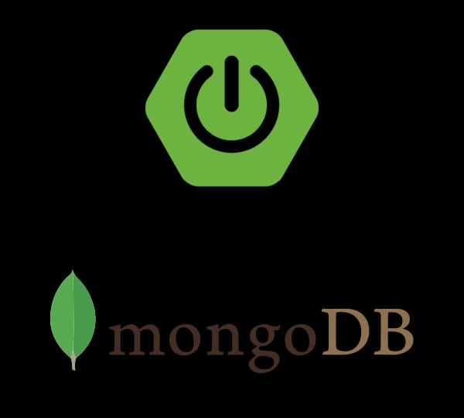
MongoDB
MongoDB is the leading modern, general purpose database platform empowering innovators to create, transform, and disrupt industries by unleashing the power of software and data.

Slide 14
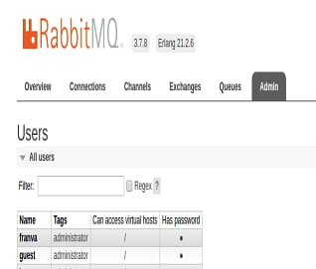
RabbitMQ
RabbitMQ is open source message broker software (sometimes called message-oriented middleware) that implements the Advanced Message Queuing Protocol (AMQP). Client libraries to interface with the broker are available for all major programming languages.

Slide 15
Maven
Maven is used for Java-based projects, helping to download dependencies, which refers to the libraries or JAR files. The tool helps get the right JAR files for each project as there may be different versions of separate packages.

Slide 16
Unit Test Coverage
Unit Testing is a one of the testing done by the developers to make sure individual unit or component functionalities are working fine. We can write unit test case by using Mockito and webController.
For injecting Mockito Mocks into Spring Beans, we need to add the Mockito-core dependency in our build configuration file.
Maven users can add the following dependency in your pom.xml file.
<dependency> <groupId>org.mockito</groupId> <artifactId>mockito-core</artifactId>
<version>2.13.0</version>
</dependency>
<dependency>
<groupId>org.springframework.boot</groupId>
<artifactId>spring-boot-starter-test</artifactId> <scope>test</scope>
</dependency>

Slide 17
Use case of the Application
This application can be very useful for the schools because by using this application students can easily get their desired data and the school will also have all the records.
This application is very simple to develop ,maintain and update.
This application can be secure using spring security.

Slide 18
THANK YOU

